Slide 1
6633 Avenue M, Brooklyn, NY 11234
Team 9: Tao Song, Erick Rosario, Mahitha Pulimi, Santhosh Kumar

Slide 2
Agenda
Property Overview
Property Analysis- Price, Rent Roll and Expansion Opportunity
Quantitative Analysis- Financial Breakdown, NOI, IRR and Sensitivity
Conclusion

Slide 3
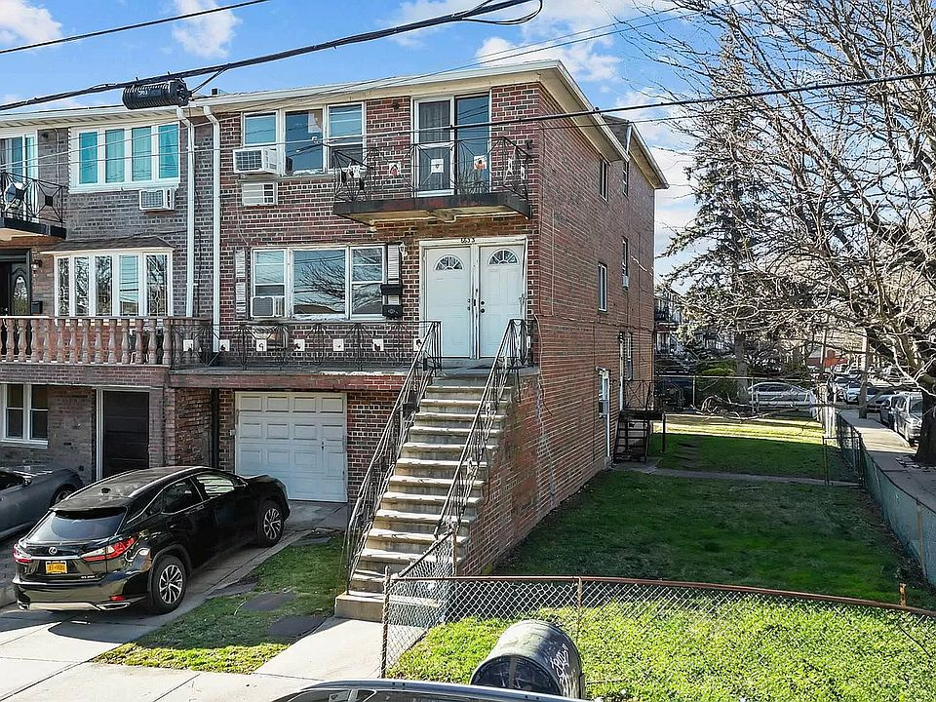
Property Overview
Three-family property for $1,050,000
7 beds and 4 baths boasting a corner lot location at 39.37 x 102
Consists of (2) 3 bed 1.5 bath apartments
(1) 1 bed apartment with total 3,152 sqft

Slide 4
Property Analysis
Purchase Price: $1,050,000.00 ($333/sqft)
Renovation Cost: $175,000.00
Closing fees @ 2%: $21,000.00
Total Costs: $1,246,000.00
Bank Loan 70% LTC: $918,750.00 (6.5% Interest; 30-year fixed)
Cash Needed: $373,800.00
LP Investment: $299,040 (80%)
GP Investment: $74,760 (20%)

Slide 5
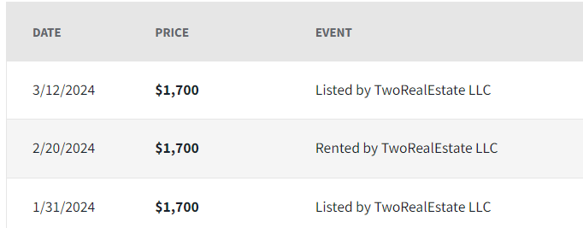
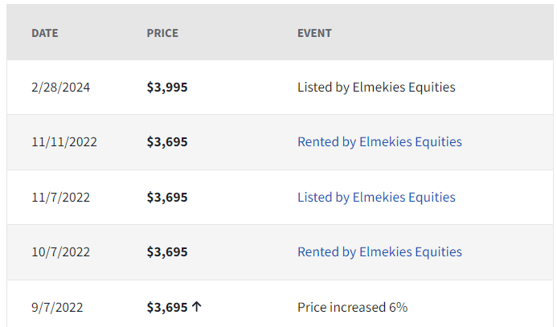
Comparable Properties
Property 1: 2600 East 21st Street #3A- Studio 1 bath
Property 2: 2442 Ocean Avenue #4G- 2 bed 2 bath

Slide 6
Devolopement & Expansion Opportunity’s
Convert additional space with entrance into a studio unit with basement
1
Increase in IRR with additional unit
2
Remodel Existing 3 units- Floors, Bathroom and Kitchen
3

Slide 7
Financial Breakdown
Exhibits A: Rent & Expenses Rent/Expenses (per month)
3 bedroom unit (first floor) | 4000
3 bedroom unit (second floor) | 4000
1 bedroom unit (ground floor) | 2300
Studio unit with basement | 1800
Vacancy Rate | 0.25
Total Rent/mo | 9,075
Repair Cost/mo | 1,051
Insurance/mo | 418
Property Taxes/mo | 744
Total Expenses/mo | 2,212

Slide 8
Financial Breakdown Con’t
LP Investor gets 80% of the sales proceeds,
8% preferred return
50% cash distribution after the preferred return
IRR 7.75% after selling the property in year 5

Slide 9
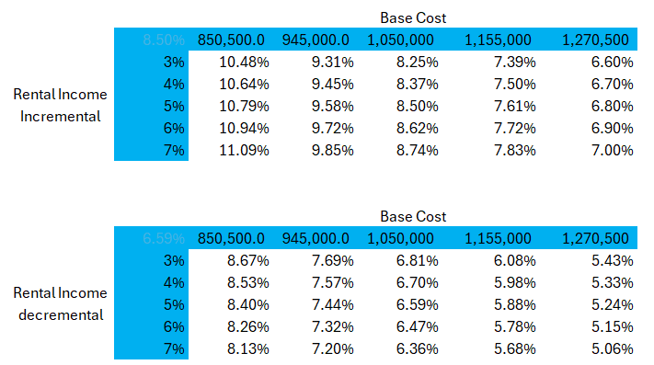
NOI, IRR and Sensitivity Analysis

Slide 10
Conclusion
Increased opportunity for success with development
Total IRR can be as high as %
Risk mitigation due to low vacancy in area
Repairs can occur within 60 days and return can begin as soon as 90 days

